Slide 1
Financial Performance
Dashboard
DESIGN BRIEF
The pages we will build in Power BI, the question each chart answers, and the colors that hold it together.
EGX listed companies · Quarterly statements · Sample: Juhayna (JUFO)
Notes:
This deck is the agreed design before we build in Power BI. Every page and chart is here with the question it answers, so we build only what serves a question.

Slide 2
Six pages, six questions
THE DASHBOARD
#
Page
The question it answers
Data from
01
Overview
How is the company performing financially?
Executive summary
02
Profit & Loss
Is the company growing profitably?
Income statement
03
Balance Sheet
What does it own, and how is it funded?
Balance sheet
04
Liquidity & Leverage
Can it meet its obligations?
Balance sheet + P&L
05
Working Capital
How efficiently does it use operating assets?
Balance sheet + P&L
06
Compare Companies
How does it stack up against peers?
All statements
Financial Performance Dashboard · Design brief · 2
Notes:
Each page answers exactly one business question. The page title in Power BI is the page name, and the subtitle is the question, so a reader always knows why the page exists.

Slide 3
One meaning per color, on every page
COLOR SYSTEM
Dark brown
Orange
Tan
Amber
#6B3A18
#D8621C
#E8AE84
#F4B04F
Revenue, assets, subtotals, selected state
Costs, net income, liabilities
EBITDA, equity, second series
Operating expenses (OPEX) and cash
Light Pink
Dark Orange
Dark Brown
Sidebar
#F9DFD0
#A24A15
#50391D
#2A1A0E
Debt and warnings, always with words
Positive change, always with words
Prior year, other, thresholds
Navigation panel background
Financial Performance Dashboard · Design brief · 3
Notes:
Colors carry meaning, not decoration: dark brown and tan = the business growing (revenue, EBITDA, equity); orange = what it costs or owes; red and green only flag good or bad and always sit next to words like "Above 3x: watch". Page background #FDEFDC, cards #FFFFFF, text #4A2A12.

Slide 4
Every page reads the same way
PAGE LAYOUT
1
2
3
4
Navigation
Filters
KPI column
Charts
Dark sidebar on the left with the page navigator and the Year and Company filters. Same place on every page.
Year and Company slicers in the sidebar. Synced across pages.
4 to 6 cards beside the charts: the value and one line of context.
2 to 4 cards. Each title says what the chart shows.
Titles are questions
Partial years say so
One unit
"Is profit turning into cash?" beats "OCF vs NI".
2026 is labeled 2026 H1, so nobody reads a drop.
EGP billions (bn), ratios as x, margins as %.
Financial Performance Dashboard · Design brief · 4
Notes:
Readers learn the layout once. Navigation left, then headline numbers, then charts that explain them. The three rules below the layout stop the most common misreadings.

Slide 5
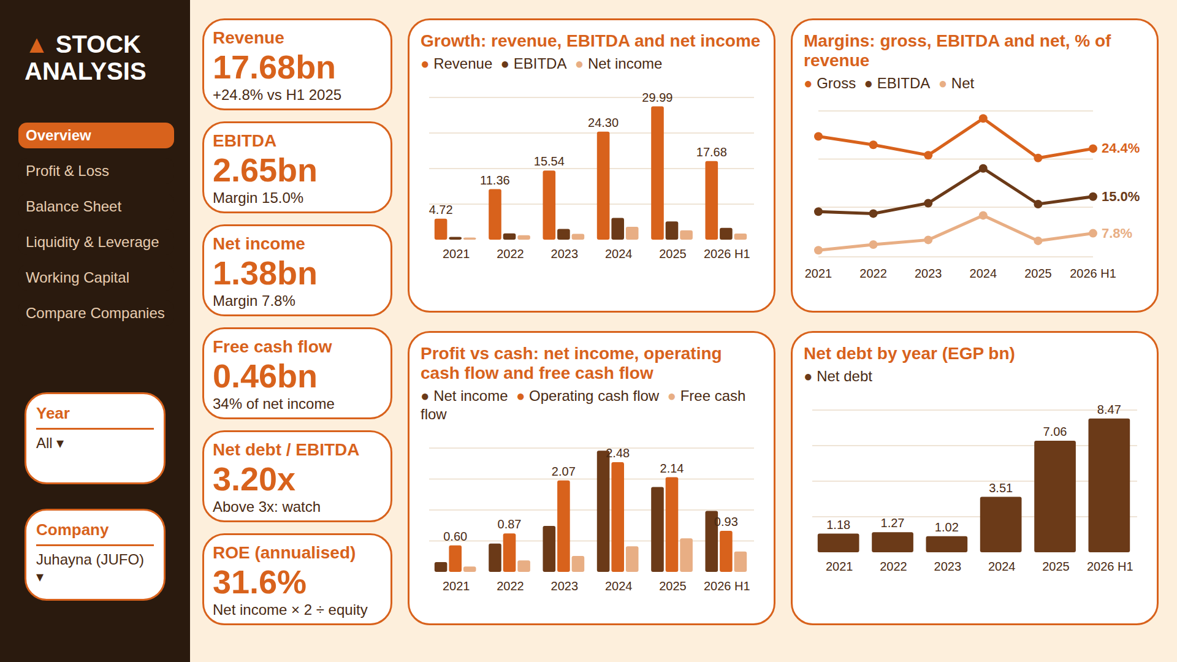

Slide 6
Each visual and its job
PAGE 1 · OVERVIEW
How is the company performing financially? The one page an executive reads. Headline numbers first, then four charts that explain growth, profitability, cash and debt.
Visual
Chart type
Question it answers
Measures
KPI row
Cards
What are the headline numbers right now?
Revenue, EBITDA, Net Income, FCF, Net Debt / EBITDA, ROE
Growth
Clustered column
Is the business growing, and is profit growing with it?
Revenue, EBITDA, Net Income
Margins
Line
Is each pound of revenue becoming more profitable?
Gross, EBITDA and Net margin %
Profit vs cash
Clustered column
Is profit turning into real cash?
Net Income, Operating Cash Flow, FCF
Net debt
Column
Is the company borrowing more over time?
Net Debt
Financial Performance Dashboard · Design brief · 6
Notes:
Every visual on this page with the question it answers and the measures behind it. The one page an executive reads. Headline numbers first, then four charts that explain growth, profitability, cash and debt.

Slide 7
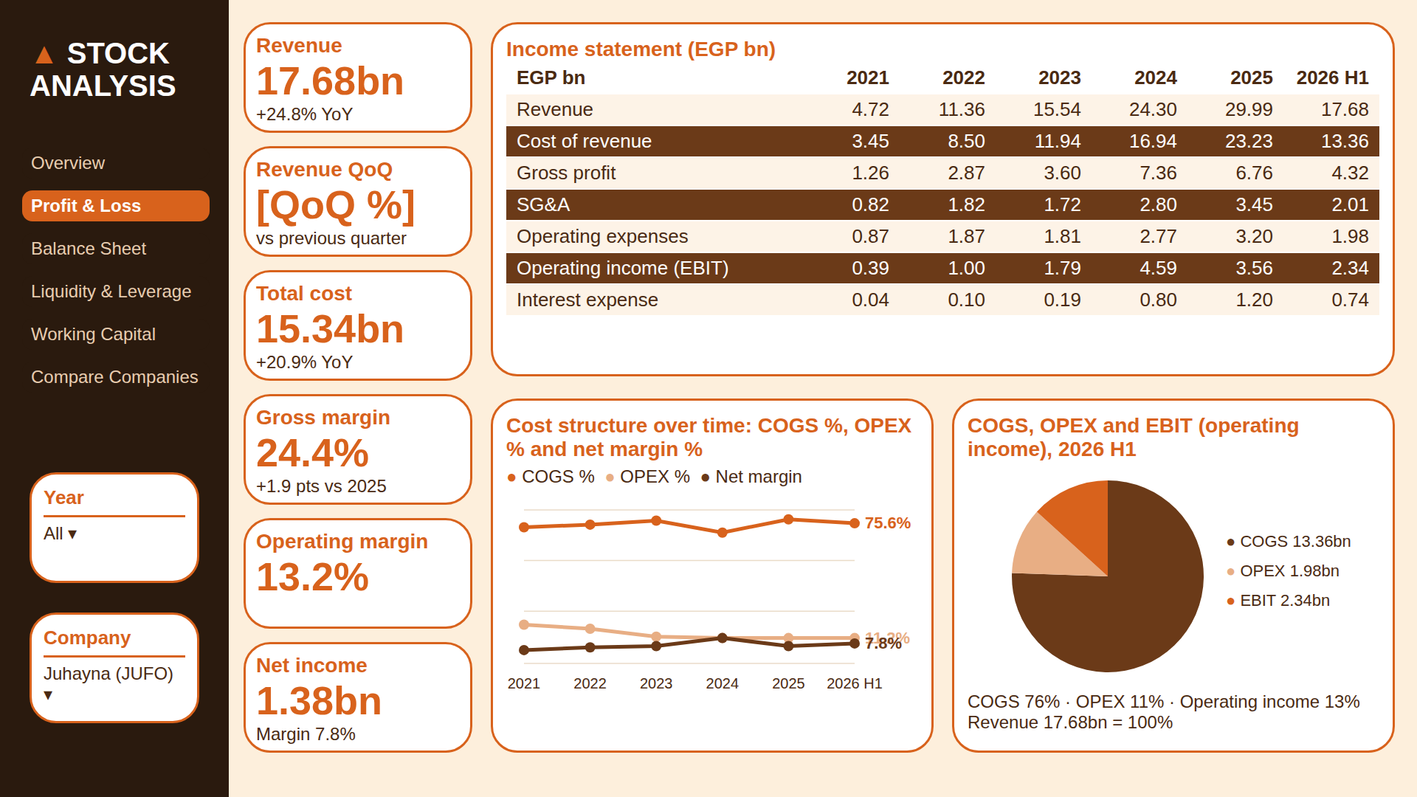

Slide 8
Each visual and its job
PAGE 2 · PROFIT & LOSS
Is the company growing profitably? Follows revenue down to net income and shows which costs grow faster than sales.
Visual
Chart type
Question it answers
Measures
KPI row
Cards
Are revenue and costs growing, and at what margin?
Revenue, YoY / QoQ %, Total Cost, Margins
Income statement
Matrix
What happened, line by line, period by period?
Financial Term × period, Value
Revenue to net income
Waterfall
Where does revenue go before it becomes profit?
Revenue, COGS, OPEX, Interest, Tax
Cost structure
Line
Are costs growing faster than revenue?
COGS %, OPEX %, Net margin %
Revenue split
100% bar
Where does each pound of revenue go?
COGS, OPEX, Operating income
Financial Performance Dashboard · Design brief · 8
Notes:
Every visual on this page with the question it answers and the measures behind it. Follows revenue down to net income and shows which costs grow faster than sales.

Slide 9
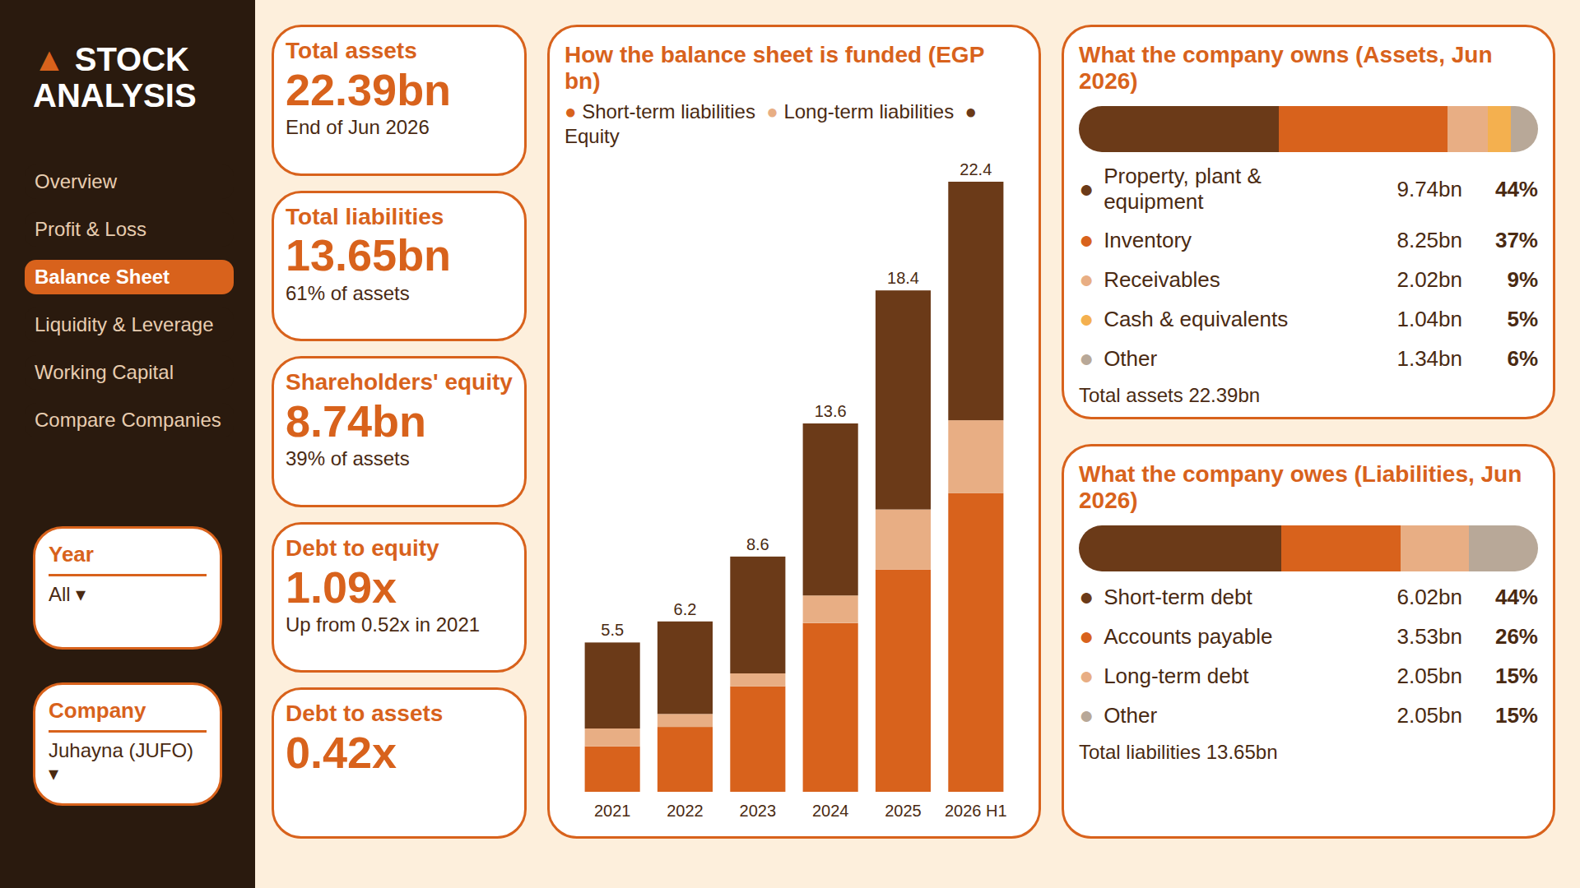

Slide 10
Each visual and its job
PAGE 3 · BALANCE SHEET
What does the company own, and how is it funded? Shows the size of the company and whether growth is paid for with debt or with shareholders’ money.
Visual
Chart type
Question it answers
Measures
KPI row
Cards
How big is the company and how leveraged?
Total Assets, Liabilities, Equity, D/E, D/A
Funding
Stacked column
Is growth funded by debt or by equity?
Short-term liabilities, long-term liabilities, Equity
What it owns
100% bar
Where is the money invested?
PP&E, Inventory, Receivables, Cash, Other
What it owes
100% bar
What does it owe, and how soon?
Short-term debt, Payables, Long-term debt, Other
Financial Performance Dashboard · Design brief · 10
Notes:
Every visual on this page with the question it answers and the measures behind it. Shows the size of the company and whether growth is paid for with debt or with shareholders’ money.

Slide 11
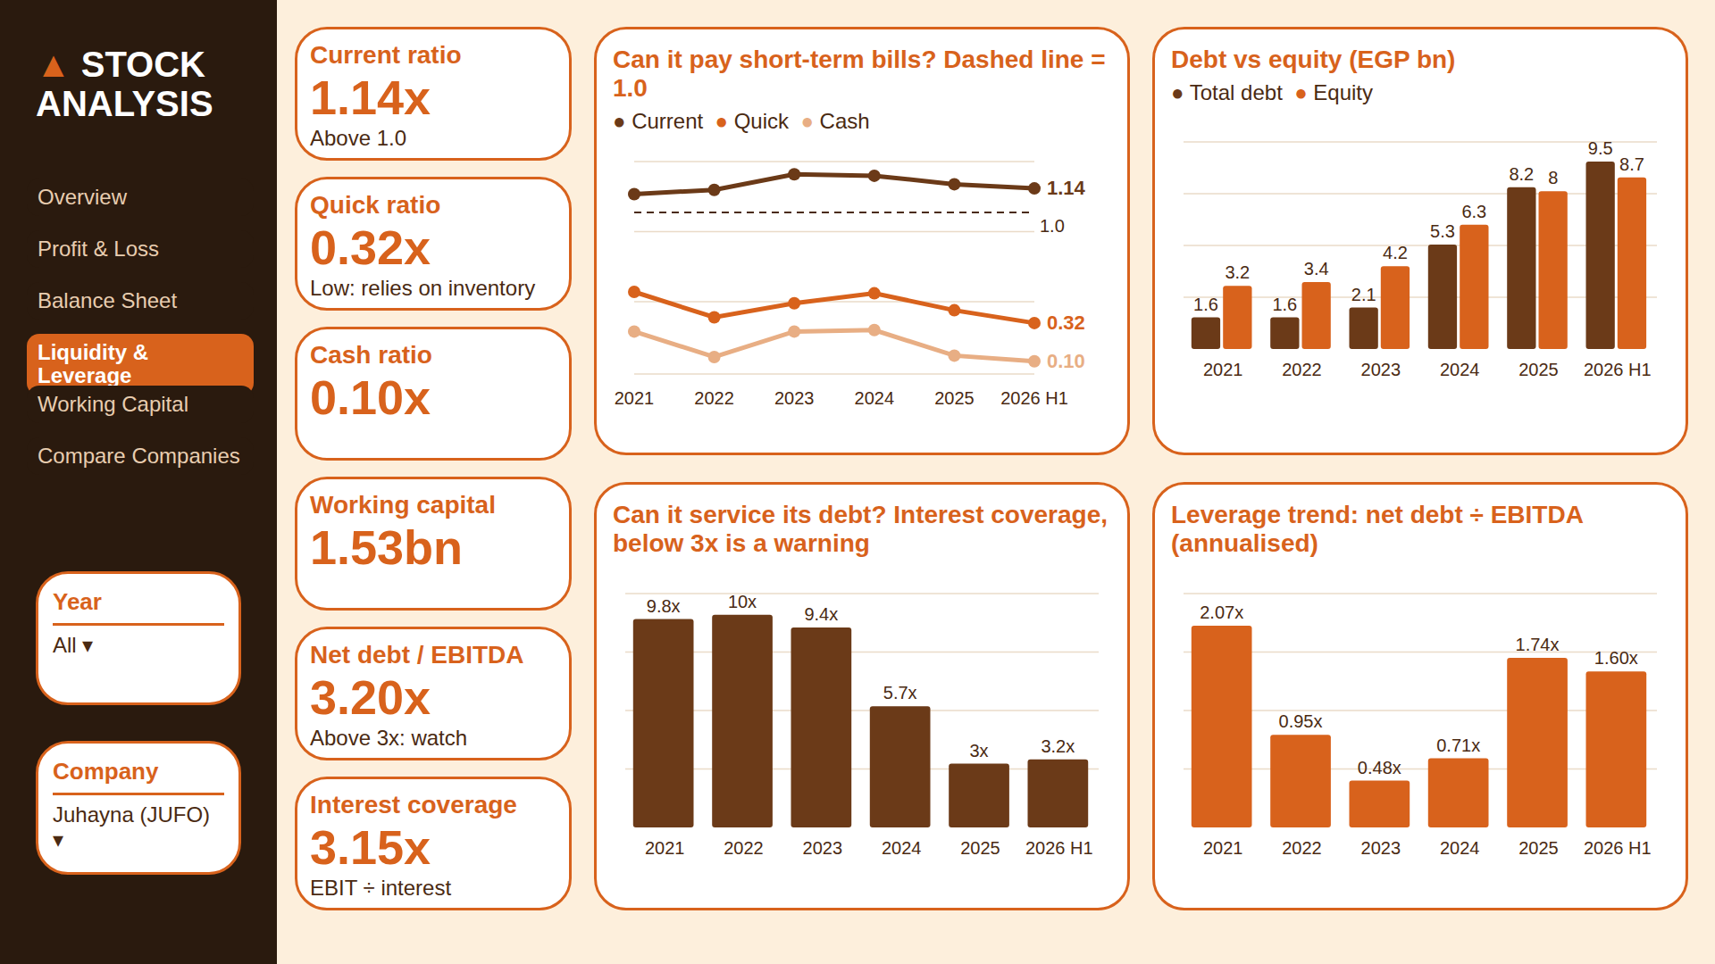

Slide 12
Each visual and its job
PAGE 4 · LIQUIDITY & LEVERAGE
Can the company meet its obligations? Short-term: can it pay this year’s bills. Long-term: can it carry and service its debt.
Visual
Chart type
Question it answers
Measures
KPI row
Cards
Is any ratio in the danger zone?
Current, Quick, Cash ratio, Net Debt / EBITDA, Coverage
Short-term bills
Line + 1.0 line
Can it pay bills due within a year?
Current, Quick, Cash ratio
Debt vs equity
Clustered column
Is leverage rising?
Total Debt, Total Equity
Debt service
Column
Can profit cover the interest bill? Below 3x is a warning.
Interest Coverage
Leverage trend
Column
How many years of EBITDA would repay net debt?
Net Debt / EBITDA
Financial Performance Dashboard · Design brief · 12
Notes:
Every visual on this page with the question it answers and the measures behind it. Short-term: can it pay this year’s bills. Long-term: can it carry and service its debt.

Slide 13
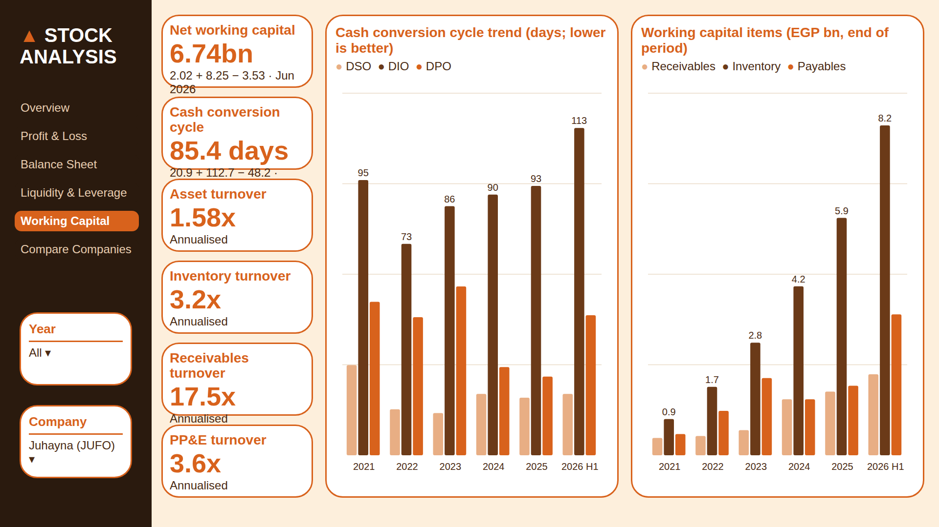

Slide 14
Each visual and its job
PAGE 5 · WORKING CAPITAL
How efficiently does the company use its operating assets? Shows how much cash is tied up in running the business and how long it takes to come back.
Visual
Chart type
Question it answers
Measures
Equations
Cards
How much cash is tied up, and for how many days?
AR + Inventory − AP; DSO + DIO − DPO
Cash cycle
Clustered column
Is the cash cycle getting longer?
DSO, DIO, DPO
Working capital items
Clustered column
Which item drives the change?
Receivables, Inventory, Payables
Turnover
Cards
How hard are the assets working?
Asset, Inventory, Receivables, PP&E turnover
Financial Performance Dashboard · Design brief · 14
Notes:
Every visual on this page with the question it answers and the measures behind it. Shows how much cash is tied up in running the business and how long it takes to come back.

Slide 15
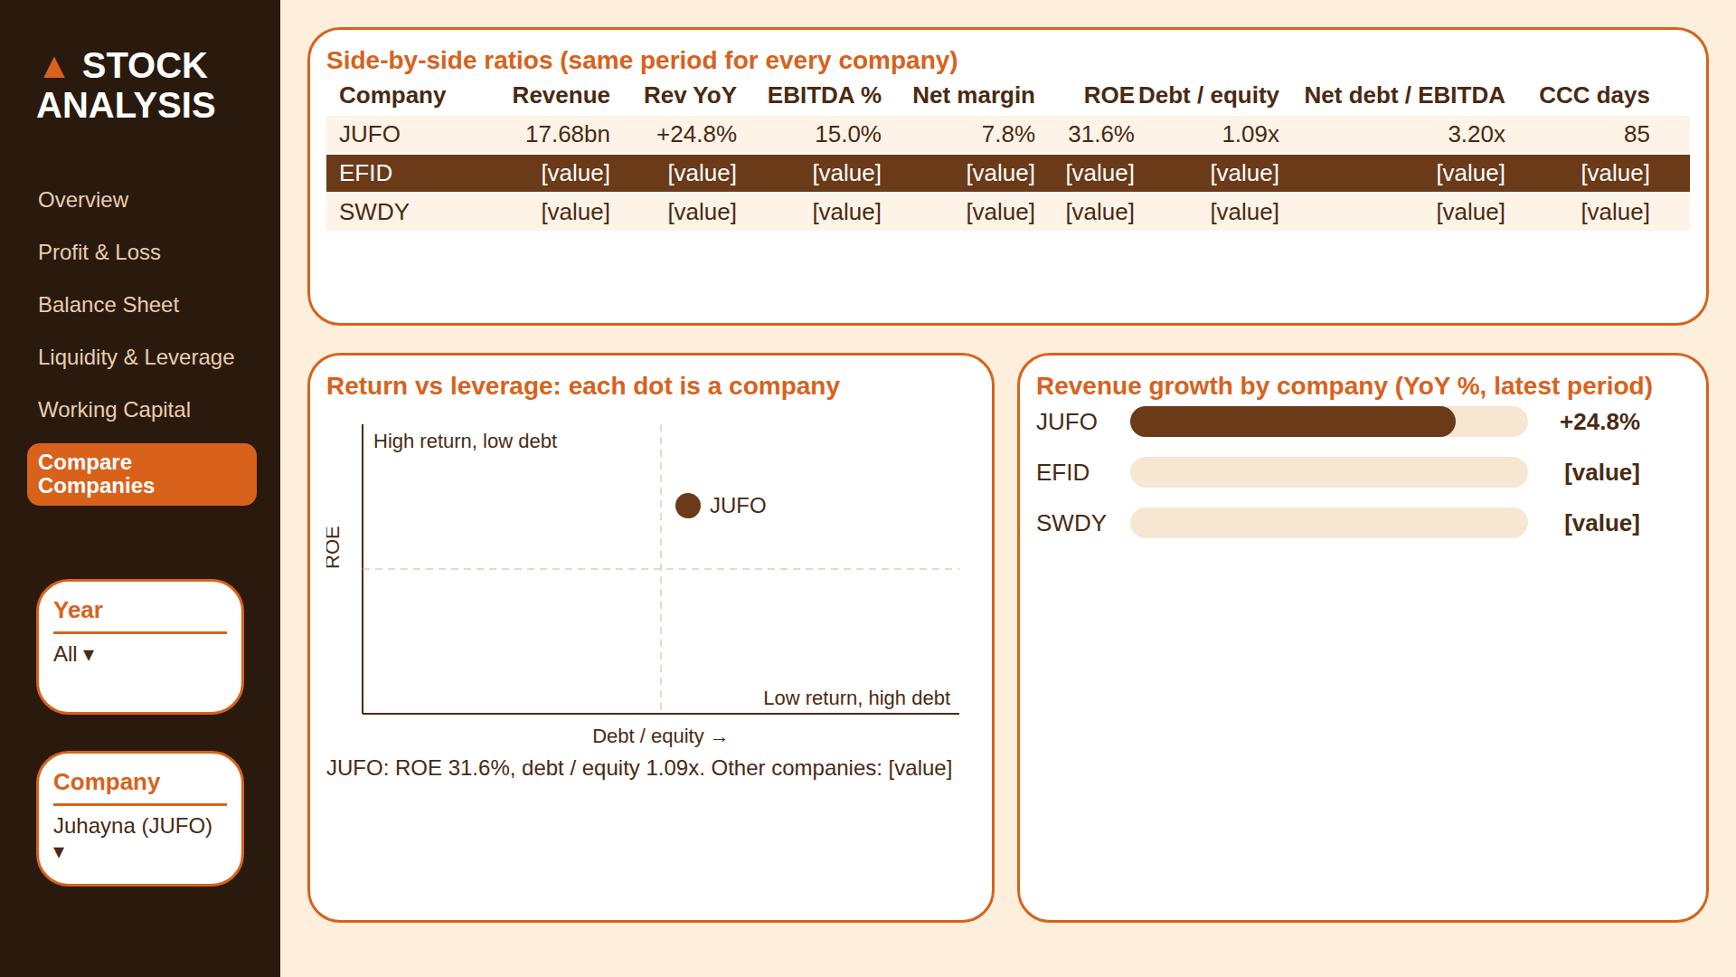

Slide 16
Each visual and its job
PAGE 6 · COMPARE COMPANIES
How does the company stack up against its peers? Puts the selected companies side by side on the same ratios for the same period.
Visual
Chart type
Question it answers
Measures
Company picker
Slicer chips
Which companies are we comparing?
DimCompany (multi-select)
Ratio table
Table
How does each company rank on the same metrics?
Revenue, YoY, margins, ROE, D/E, CCC
Return vs leverage
Scatter
Who earns high returns without heavy debt?
ROE (y) vs Debt / Equity (x)
Growth ranking
Bar
Who is growing fastest?
Revenue YoY %
Financial Performance Dashboard · Design brief · 16
Notes:
Every visual on this page with the question it answers and the measures behind it. Puts the selected companies side by side on the same ratios for the same period.

Slide 17
From brief to Power BI
NEXT
1
2
3
4
Apply the theme
Set backgrounds
Place visuals
Check numbers
View › Themes › EGX_Financials_theme.json
One 1280×720 image per page
On the white cards, as in these mockups
Assets = Liabilities + Equity, every period
Financial Performance Dashboard · Design brief · 17
Notes:
The last step catches the most common modelling mistake: summing balance-sheet values across quarters.

